Slide 1
presentation title

Slide 2
agenda
Project description and motivation
Major technical solutions compared
Project Demo
GitHub tour
Development journey (plan x actual experience)
Major challenges
Major accomplishments
Future plans (for us or someone else taking over)
Why buy our product?

Slide 3
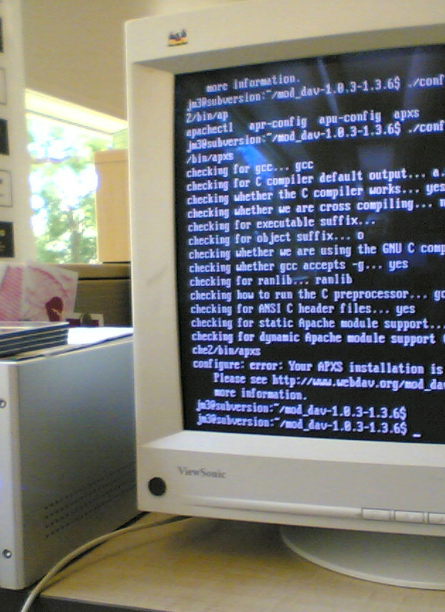
Project description and motivation

Slide 4

Major solutions compared

Slide 5
Major technical solutions compared
Oracle Cloud Advantages:
Free of charge
Easy To understand (at the beginning)
Functional Terminal
Supports Multiple images and different ways of creating ssh keys at instance creation
Oracle Cloud Disadvantages:
Complex
Issues Connecting to the DNS
Firewall creation at the beginning made us run into many issues

Slide 6
Major technical solutions compared
OVH Cloud Advantages:
Easy To understand and use
Functional Terminal
Supports Multiple linux distributions (more than oracle)
Oracle Cloud Disadvantages:
Not Free/ Cost varies based on what you need
Ss
Firewall creation at the beginning made us run into many issues

Slide 7
Project Demo

Slide 8
GitHub tour

Slide 9
Development journey
plan VS actual experience

Slide 10
Plan Actual experience
Configure ssh for key based log-in
Set file permissions for the web server
Secure server through firewall
Cron jobs for automatic git pulls to update the website
Daily backups
Systemd vs CronJobs
Hosted website directly from GitHub into our DNS to check if all worked well
Run into many issues with OracleCLoudsince we pasted our public keys at first that prevented us from logging in remotely
Once fixed run into many more issues that did not give us an error message and the ip would not point to anything .
We figured that the firewall was preventing proper startup
We switched to a new VPS OVH cloud
Trouble at first due to school wifi

Slide 11
Major challenges

Slide 12
Challenges
Know your material in advance
Anticipate common questions
Rehearse your responses
Maintaining composure during the Q&A session is essential for projecting confidence and authority. Consider the following tips for staying composed:
Stay calm
Actively listen
Pause and reflect
Maintain eye contact

Slide 13
Major accomplishments
Configuration
Firewall
SSH Connection Failure
DNs not pointing to the address
Disabling Apache
Troubleshooting

Slide 14
Future plans
Link the dns to the vps ip address
Configure the firewall

Slide 15
thank you!
Talia Muro
Mariam Salim
Selihom Efrem Ogbe

